Slide 1
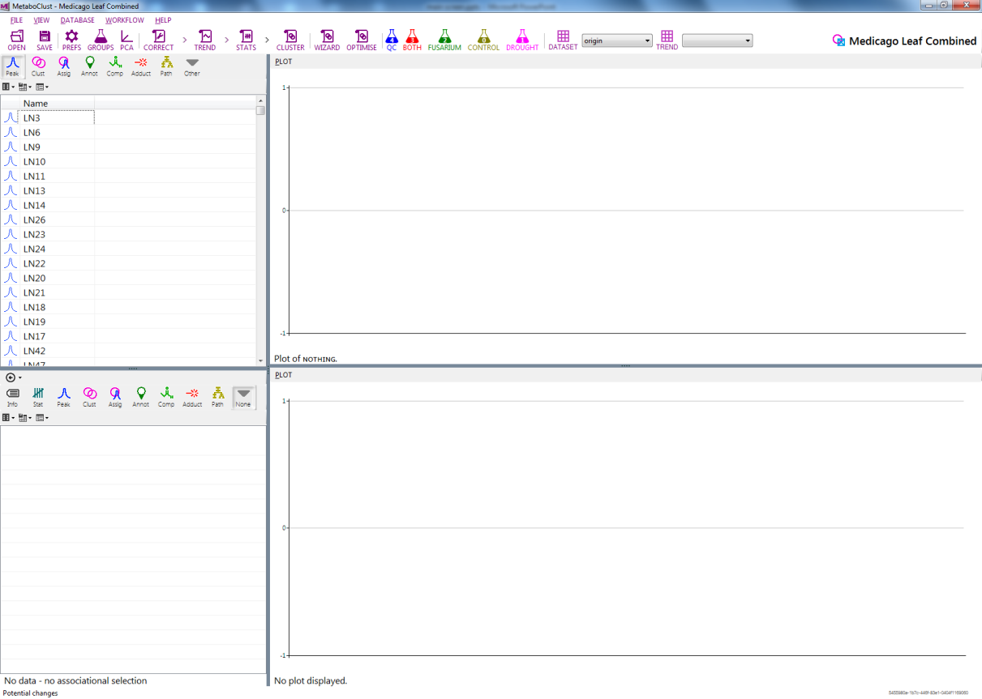
Menu bar
View options
Dataset
Tool bar
Primary list
Peak plot
Cluster plot
Secondary list
Status bar

